Slide 1



Slide 2

Mid-term Presentation
Major I
Rajul Dubey | Devesh Yadav | Shriyansh Kaushik | Karan Sharma
R171218081 | R171218038 | R171218100 | R171218117
500069424 | 500069565 | 500067485 | 500070100
Under the guidance of
Dr. Gagan Deep Singh Assistant Professor
Department of Cybernetics Cluster
University of Petroleum and Energy Studies

Slide 3
Chest X-Ray Analyzer

Slide 4
ABSTRACT
Advances in machine learning and artificial intelligence techniques promise to increase computer-assisted diagnostic tests quickly, accurately, and reliably. And such strategies are important exclusively in areas with heavy loads or resources. These regions often show an increase in infectious diseases and report high mortality. Our research in machine learning and artificial intelligence algorithms aims to improve diagnostic accuracy and reliability, with the aim of defining and behaving algorithms considering Chest-X-Ray analysis as an area of our interest.

Slide 5
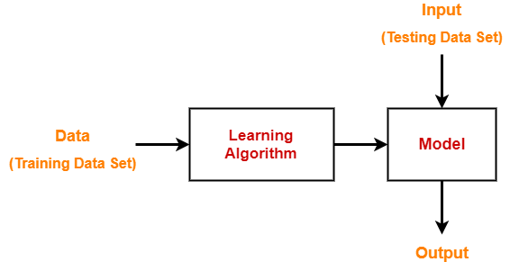
INTRODUCTION
Chest X-Rays analysis is an effective research tool for medical image analysis and computer-assisted radiology diagnostics. The main goal is to improve the quality and productivity of radiologists by providing a computerized diagnostic and diagnostic system. A number of studies have been conducted on the use of machine learning techniques to produce a high-quality X-ray image separation method. Some review papers also have been published discussing various aspects of medical imaging analysis and computer-assisted radiology diagnostics. But here we are trying to complete existing methods by pointing to methods of chest X-ray imaging in the use of machine learning techniques. Our review begins with basic information for medical image analysis, chest radiography, and machine learning.

Slide 6
LITERATURE REVIEW
A study conducted by Tape and Mushlin (1988) to study the effect of routine chest x-rays of pre-operative patients at risk for postoperative disease. Patient records from 341 admissions were reviewed to determine the relationship between chest x-ray results and postoperative chest complications. Patients who had major abnormalities had a 40% postoperative complication rate, compared with 9% for those with normal x-rays; but only 13% of the complications occurred in patients with major abnormalities. Nine patients had x-ray findings that led to clinical action: three with potentially beneficial management changes (congestive heart failure in 2, fibrosis in 1) and six with potentially detrimental clinical action (false diagnosis of tuberculosis in 2, false diagnosis of nodules in 2, falsely normal chest x-ray in 2). None of 50 surgical cancellations occurred as a result of an abnormal x-ray. All the beneficial effects attributable to preoperative chest x-rays accrued to patients who had clinical evidence of chest disease.

Slide 7

PROBLEM STATEMENT
To develop a pathology localization framework and weakly supervised image classification as due to considering of large image capacity we adapt Deep Convolutional Neural Network (DCNN) architecture for weakly-supervised object localization.

Slide 8

OBJECTIVE
To build a suitable ML Model to predict the CATOGRIES disease by providing the chest-x-ray image as an input.
Understanding different methods for modeling CNN to get max accuracy.
Building a GUI for users and deploying it on cloud.

Slide 9
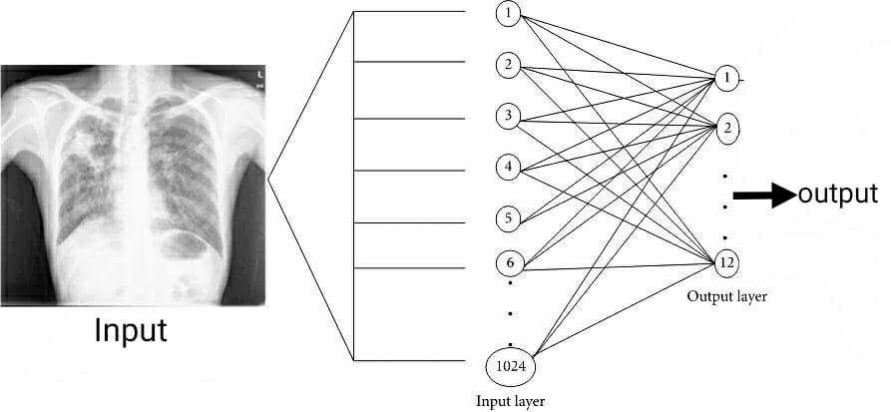
OBJECTIVE VISUALISATION

Slide 10
METHODOLOGY
We are going to build and train the CNN model, for identification of patient problem , based on his/her chest x-ray.
Firstly we will collect the maximum x-ray images and then feed those images to CNN , and then apply many operations on those images , so that model will predict actual result , with zero loss.
When CNN gets train , then we pass test image to model to check its accuracy.
If, its accuracy was less then we again manipulate the data , to minimize the loss.

Slide 11
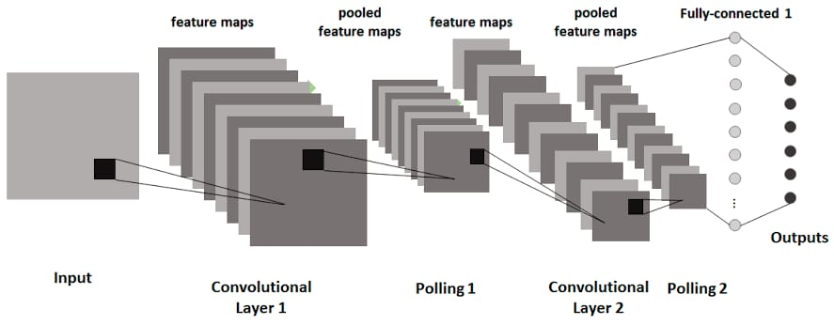
Typically, we need to observe the image, try to identify different features, shapes and edges from the image. Based on the information we gather, you would say that the object is a dog or a car and so on.
Formulation of CNN

Slide 12
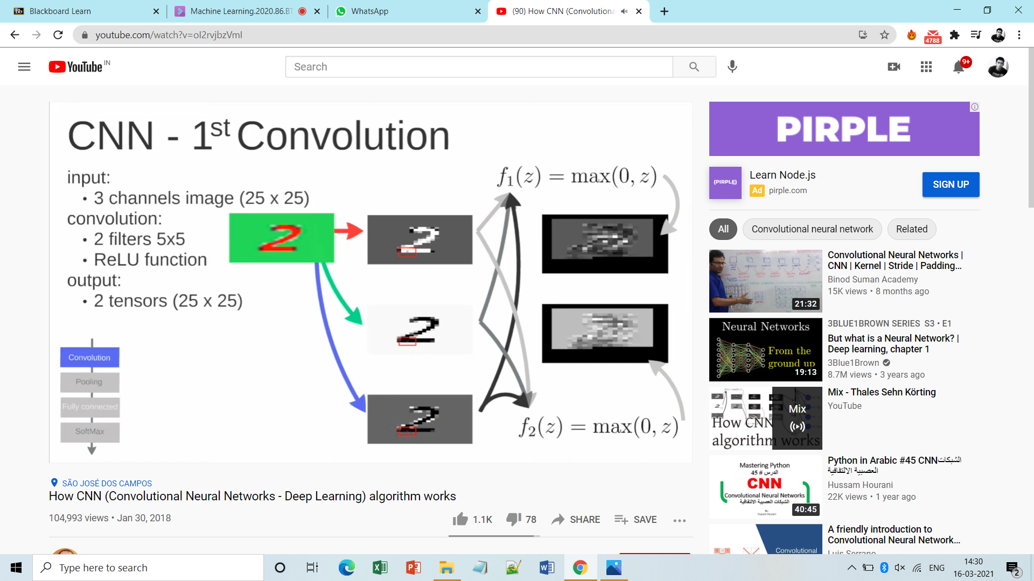
Working-Example:
Eg. Digit identification out of 0-9
Step1:

Slide 13
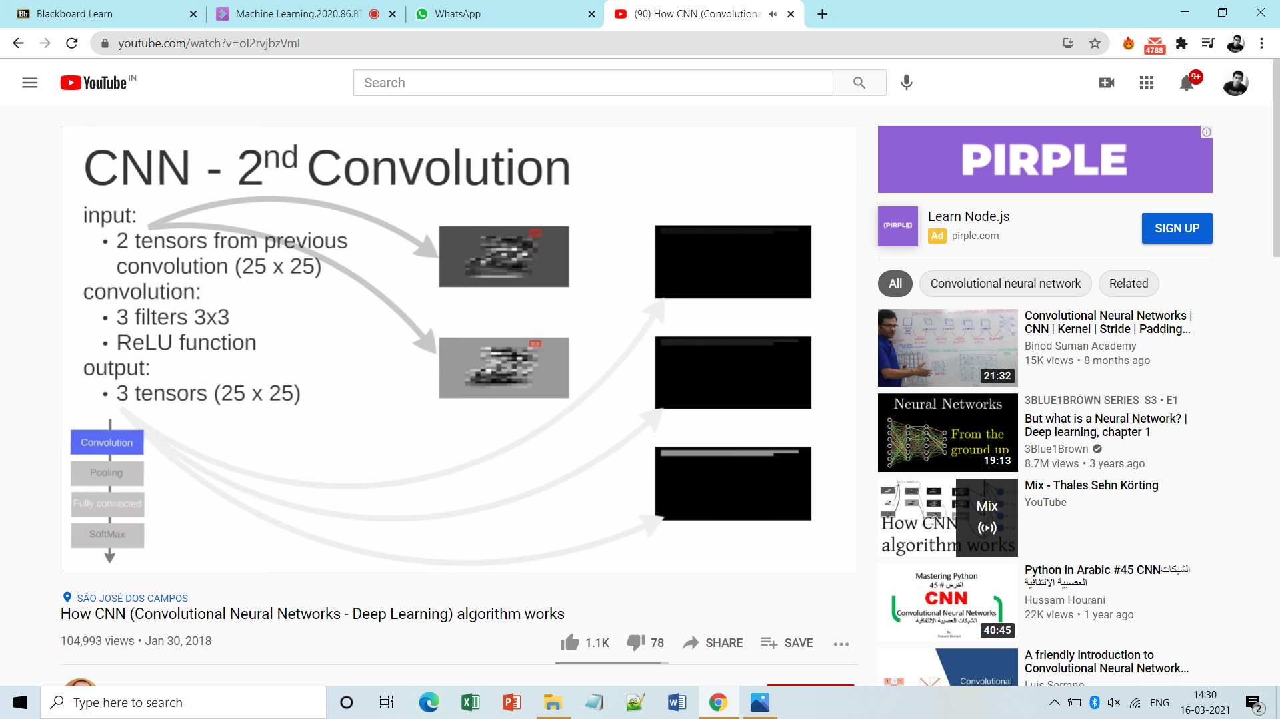
Step2:

Slide 14
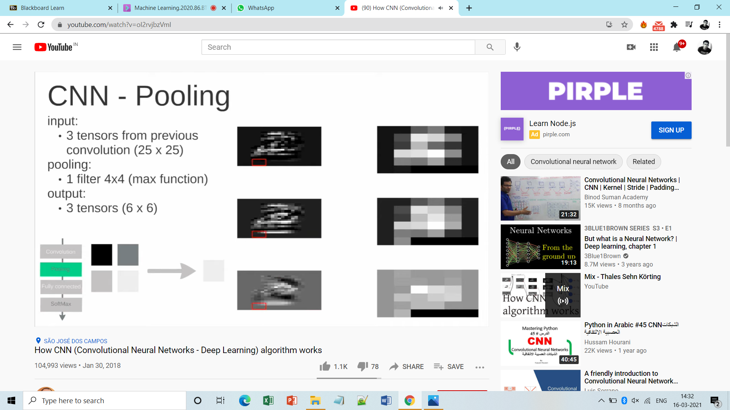
Step3:

Slide 15
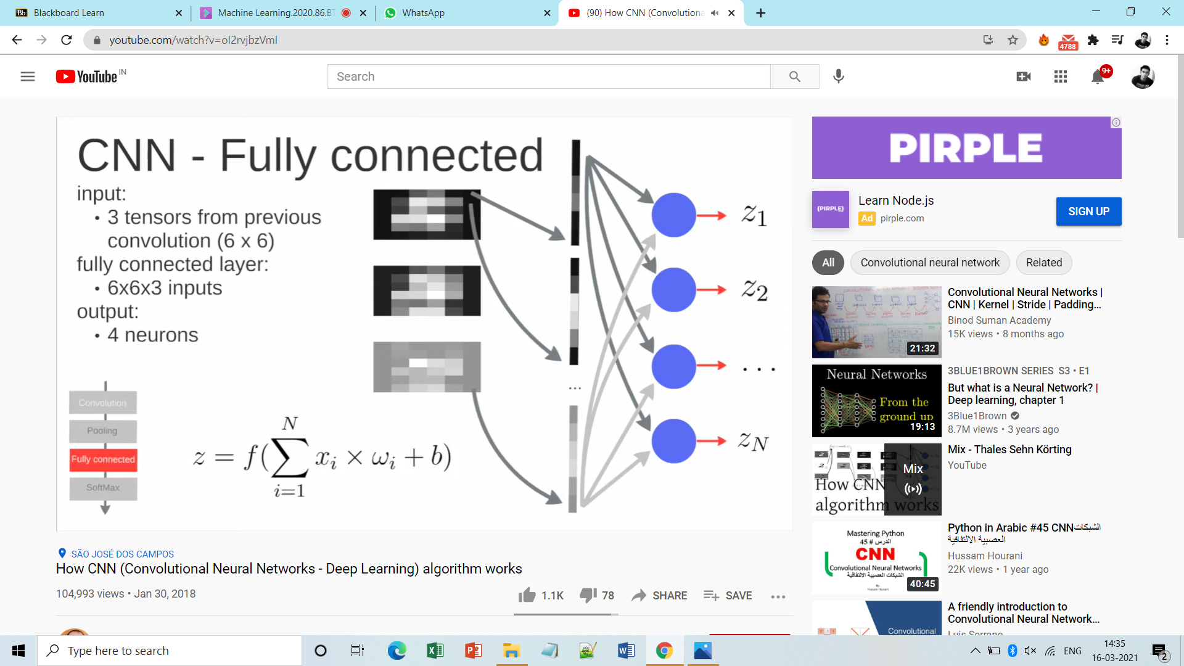
Step4:

Slide 16
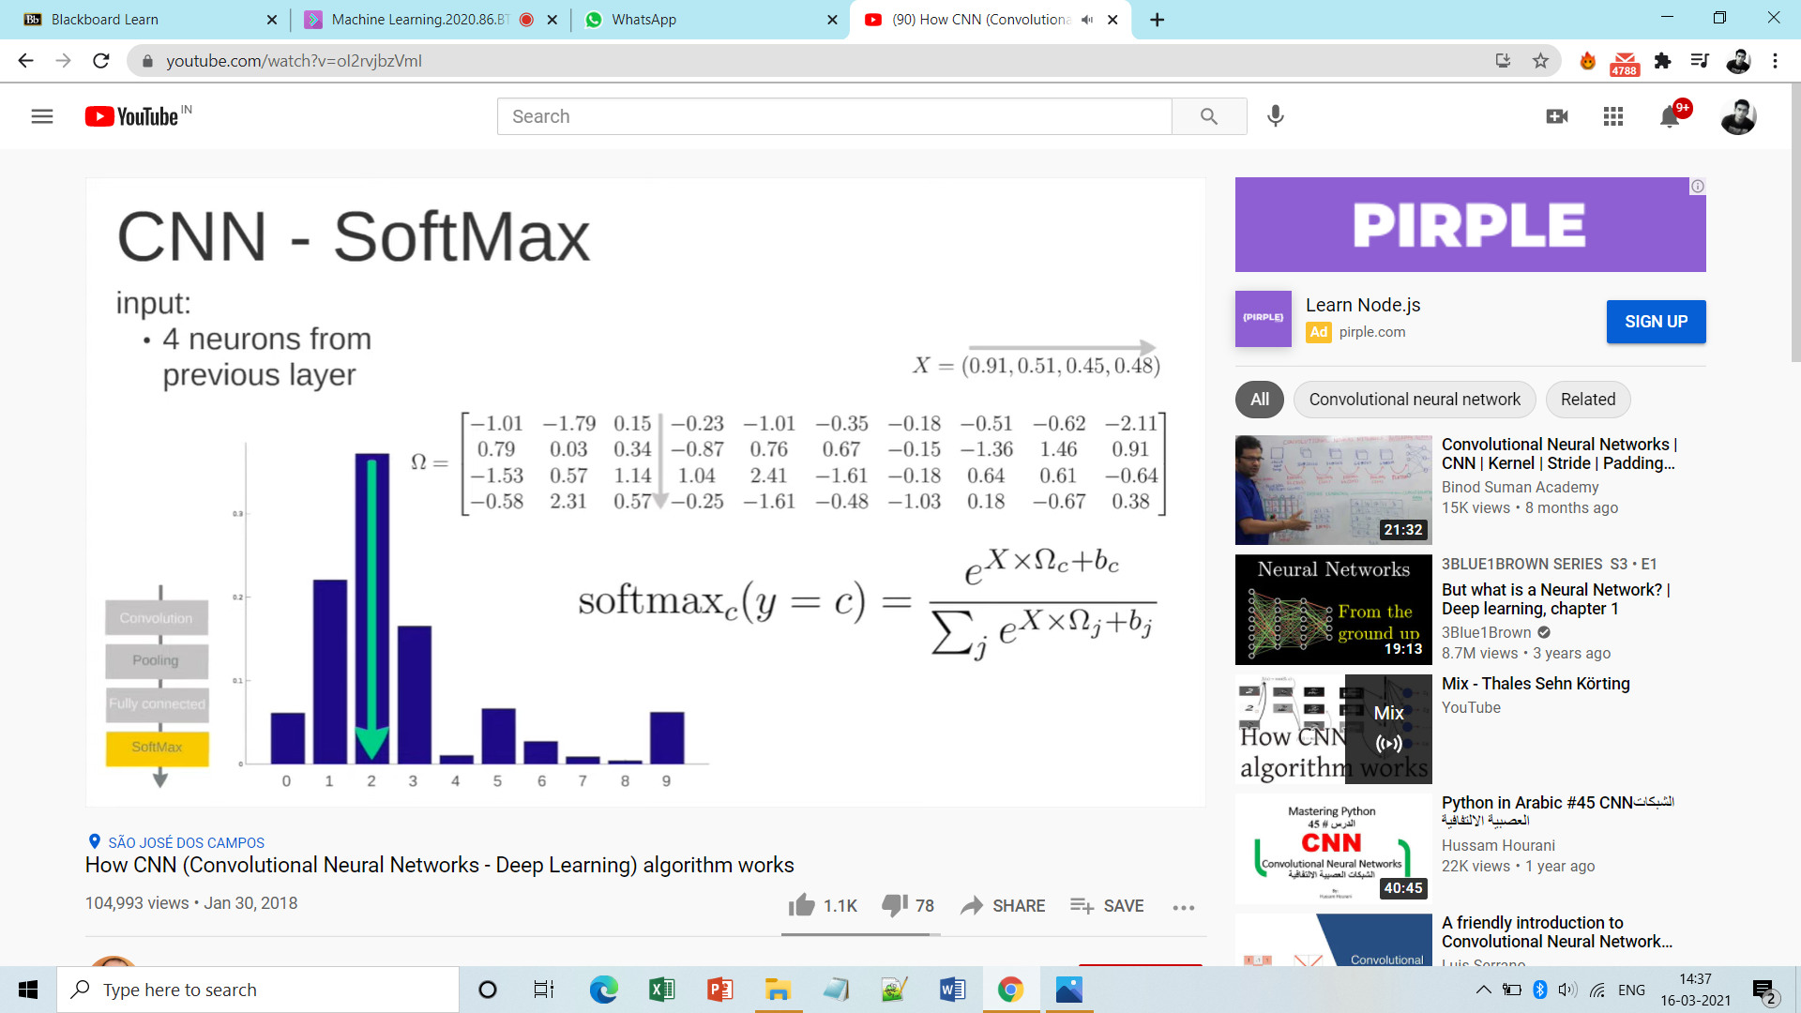
Step5:

Slide 17
PROCEDURE
The following steps are to be followed in order to meet the objective.
Download the dataset
Write function to encode the labels
Resize the image and read as grayscale
Split the data into test and train data.
Calculate loss function
Build the model
Reshape data for tensors via filters
Use optimizer
Train the model
Make the predictions.

Slide 18
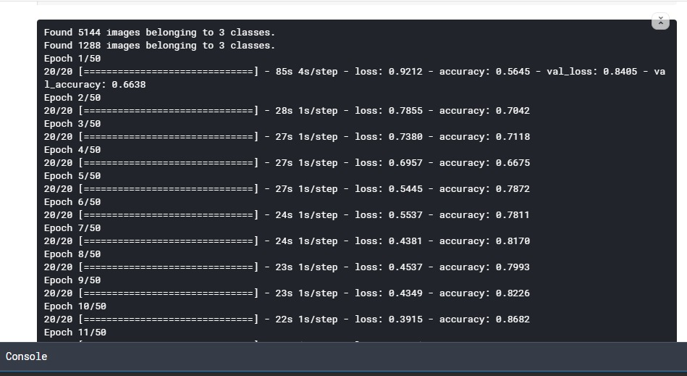
CODE OUTPUT SNIPPETS

Slide 19
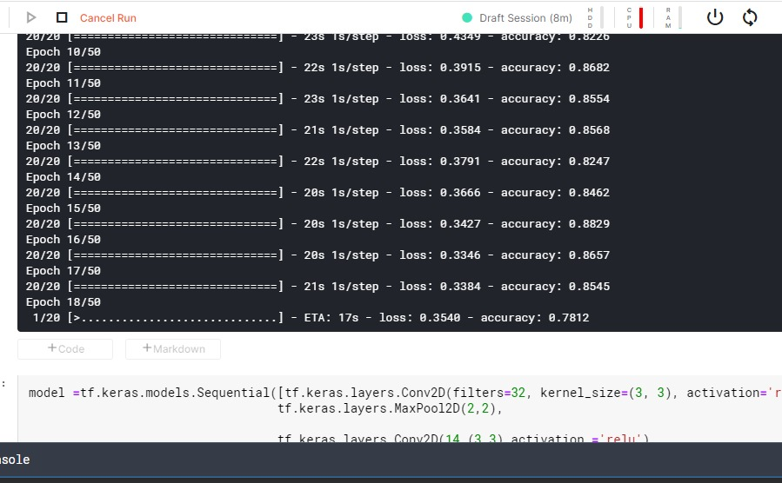

Slide 20
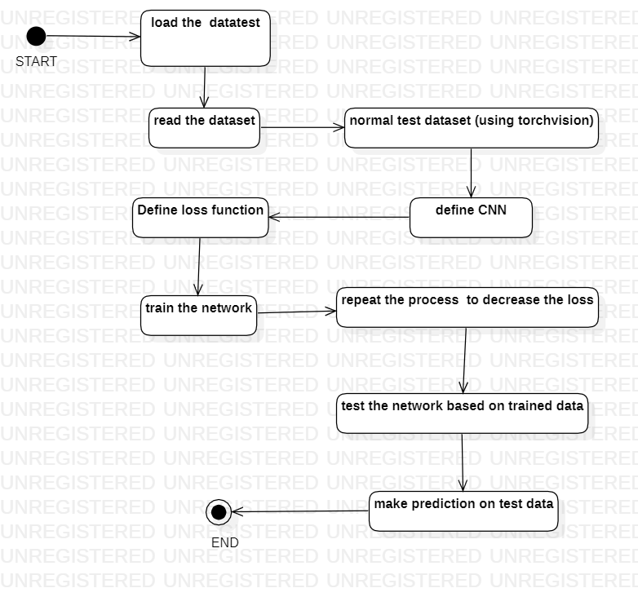
WORK FLOW

Slide 21
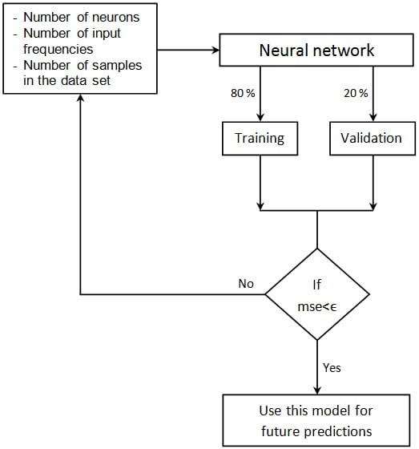

Slide 22

SYSTEM REQUIREMENTS: (SOFTWARE/HARDWARE)
While some less computationally intensive ML applications can be run on central processing units (CPUs), most currently applied ML algorithms require hardware with dedicated graphics processing units (GPUs).
Experts involved in ML development should make use of online resources for creating, sharing, and discussing ML algorithms.
Hardware
100 GB external hard disk
NVIDIA GTX 1070 GPU 8 GB
16 GB of RAM
Software
Windows(7 and above)
Python versions(2.6.X , 3.6.X)
Jupyter Notebook
Anaconda
Tensorflow
Matplotlib
Keras
GitHub

Slide 23
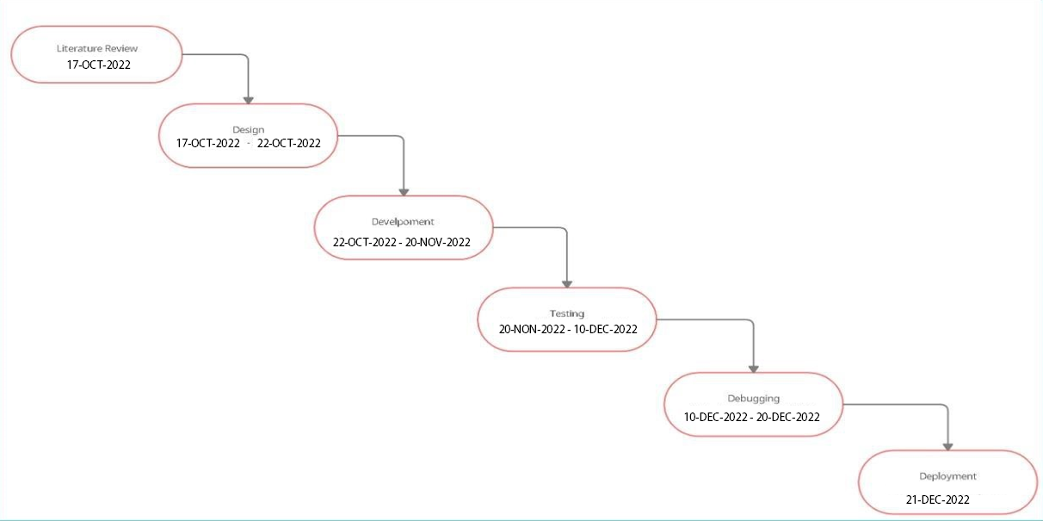

PERT CHART

Slide 24
References
1. Zha N, Patlas MN DR. Radiologist burnout is not just isolated to the United States: perspectives from Canada. J Am Coll Radiol. 2019;16(1):121-123.
2. Kane L. Medscape National Physician Burnout, Depression & Suicide Report 2019. medscape com/slideshow/2019-lifestyle-burnout-depression-6011056. Published online 2019.
3. Lee CS, Nagy PG, Weaver SJ, Newman-Toker DE. Cognitive and system factors contributing to diagnostic errors in radiology. Am J Roentgenol. 2013;201(3):611-617. doi:10.2214/AJR.12.10375
4. Delrue L, Gosselin R, Ilsen B, Landeghem A, De Mey J, duyck philippe. Difficulties in the Interpretation of Chest Radiography. In: Comparative Interpretation of CT and Standard Radiography of the Chest. ; 2011:27-49. doi:10.1007/978-3-540-79942-9_2
5. Wang X, Peng Y, Lu L, Lu Z, Bagheri M SR. Chestx-ray8: Hospital-scale chest x-ray database and benchmarks on weakly-supervised classification and localization of common thorax diseases. In: Proceedings of the IEEE Conference on Computer Vision and Pattern Recognition. ; 2017:2097-2106.
6. et al. Johnson AEW, Pollard TJ, Berkowitz S. MIMIC-CXR: A large publicly available database of labeled chest radiographs. arXiv Prepr arXiv190107042. Published online 2019.
7. et al. Irvin J, Rajpurkar P, Ko M. Chexpert: A large chest radiograph dataset with uncertainty labels and expert comparison. In: Proceedings of the AAAI Conference on Artificial Intelligence. ; 2019:590-597.
8. Taylor AG, Mielke C MJ. Automated detection of moderate and large pneumothorax on frontal chest X-rays using deep convolutional neural networks: A retrospective study. PLoS Med. 2018;15(11).
9. Rajpurkar P, Irvin J, Zhu K et al. Chexnet: Radiologist-level pneumonia detection on chest x-rays with deep learning. arXiv Prepr arXiv171105225.
10. Pan I, Cadrin-Chênevert A CP. Tackling the Radiological Society of North America Pneumonia Detection Challenge. Am J Roentgenol. 2019;213(3):568-574.

Slide 25
THANK YOU

